Slide 1
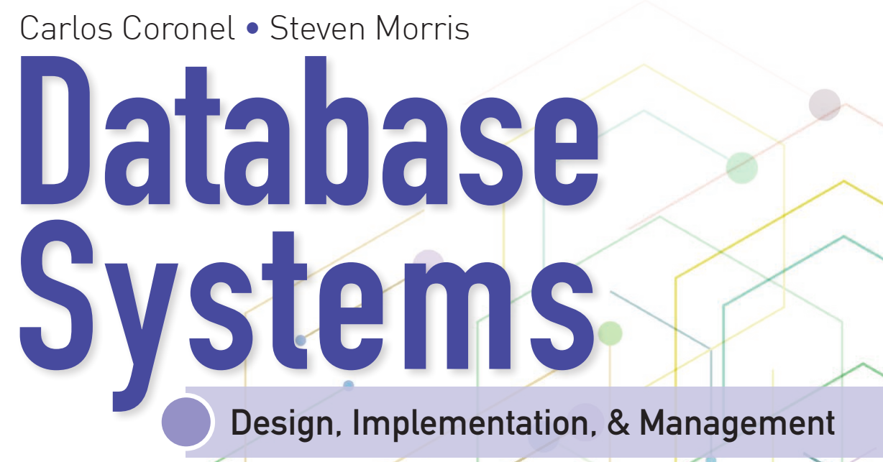
Learning Objectives
Define the difference between data and information
Describe what a database is, the various types of databases, and why they are valuable assets for decision making
Explain the importance of database design
Outline how modern databases evolved from file systems
Identify flaws in file system data management
Outline the main components of the database system
Describe the main functions of a database management system (DBMS)

Slide 2


National Economics University Faculty of Data Science & Artificial Intelligence
Database System Design, Implementation And Management Course – Database Performance
Tuning and Query Optimization
Instructor: Duc Minh Vu (FDA – SLSCM Lab)
Email: minhvd [at] neu.edu.vn
12/19/2024
Database System Design, Implementation And Management
2

Slide 3
Learning Objectives
11-1 Identify the procedures involved in database performance tuning
11-2 Describe how a DBMS processes SQL queries in each of its three phases
11-3 Explain the role of indexes in speeding up data access
11-4 Differentiate between a rule-based optimizer and a cost-based optimizer
11-5 Describe some common practices used to write efficient SQL code
11-6 Explain how to formulate queries and tune the DBMS for optimal performance

Slide 4
11-1 Database Performance-Tuning Concepts

Slide 5
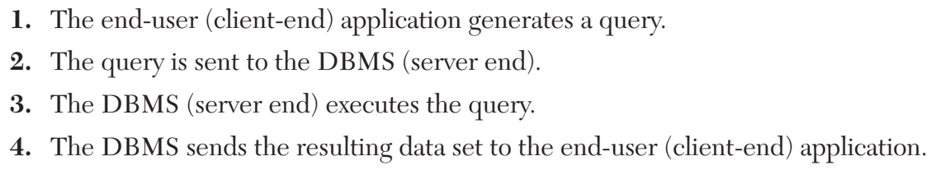
11-1 Database Performance-Tuning Concepts
End user requests and expectation:
database performance tuning A set of activities and procedures designed to reduce the response time of a database system—that is, to ensure that an end user query is processed by the DBMS in the minimum amount of time.
Good database performance starts with good database design

Slide 6
11-1a Performance Tuning: Client and Server
Database performance-tuning activities can be divided into those on the client side and those on the server side.
SQL performance tuning Activities to help generate a SQL query that returns the correct answer in the least amount of time, using the minimum amount of resources at the server end
DBMS performance tuning Activities to ensure that clients’ requests are addressed as quickly as possible while making optimum use of existing resources

Slide 7
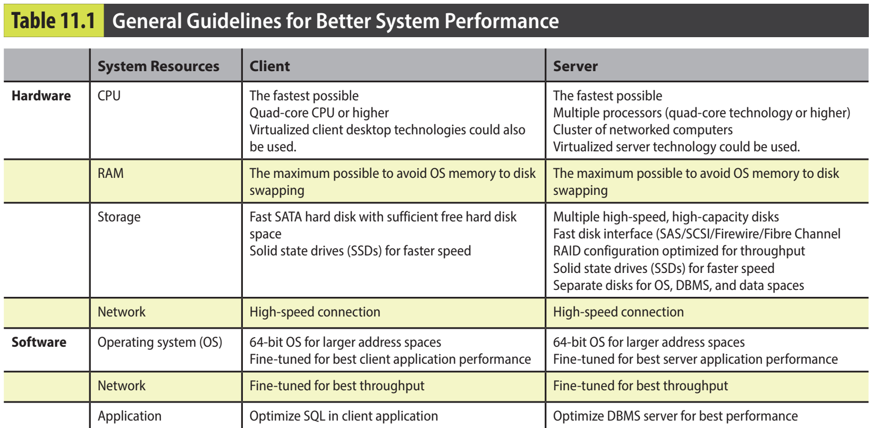

Slide 8
11-1b DBMS Architecture
The architecture of a DBMS is represented by the processes and structures (in memory and permanent storage) used to manage a database.
data file A named physical storage space that stores a database’s data. It can reside in a different directory on one or more storage locations. All data in a database is stored in data files. A typical enterprise database is normally composed of several data files. A data file can contain rows from one or more tables.
data block The smallest logical unit of assignable storage space in the database. Also known as a page.
table space In a DBMS, a logical storage space composed of one or more data files used to group related data. Also known as a file group.
data cache A shared, reserved memory area that stores the most recently accessed data blocks in RAM. Also called buffer cache.

Slide 9
11-1b DBMS Architecture
The architecture of a DBMS is represented by the processes and structures (in memory and permanent storage) used to manage a database.
SQL cache A shared, reserved memory area that stores the most recently executed SQL statements or PL/SQL procedures, including triggers and functions. Also called procedure cache
input/output (I/O) request A low-level data access operation that reads or writes data to and from computer devices.

Slide 10
11-1b DBMS Architecture
The architecture of a DBMS is represented by the processes and structures (in memory and permanent storage) used to manage a database.
Working with data in the data cache is many times faster than working with data in the data files
Most performance-tuning activities focus on minimizing the number of I/O operations because using I/O operations is many times slower than reading data from the data cache.

Slide 11
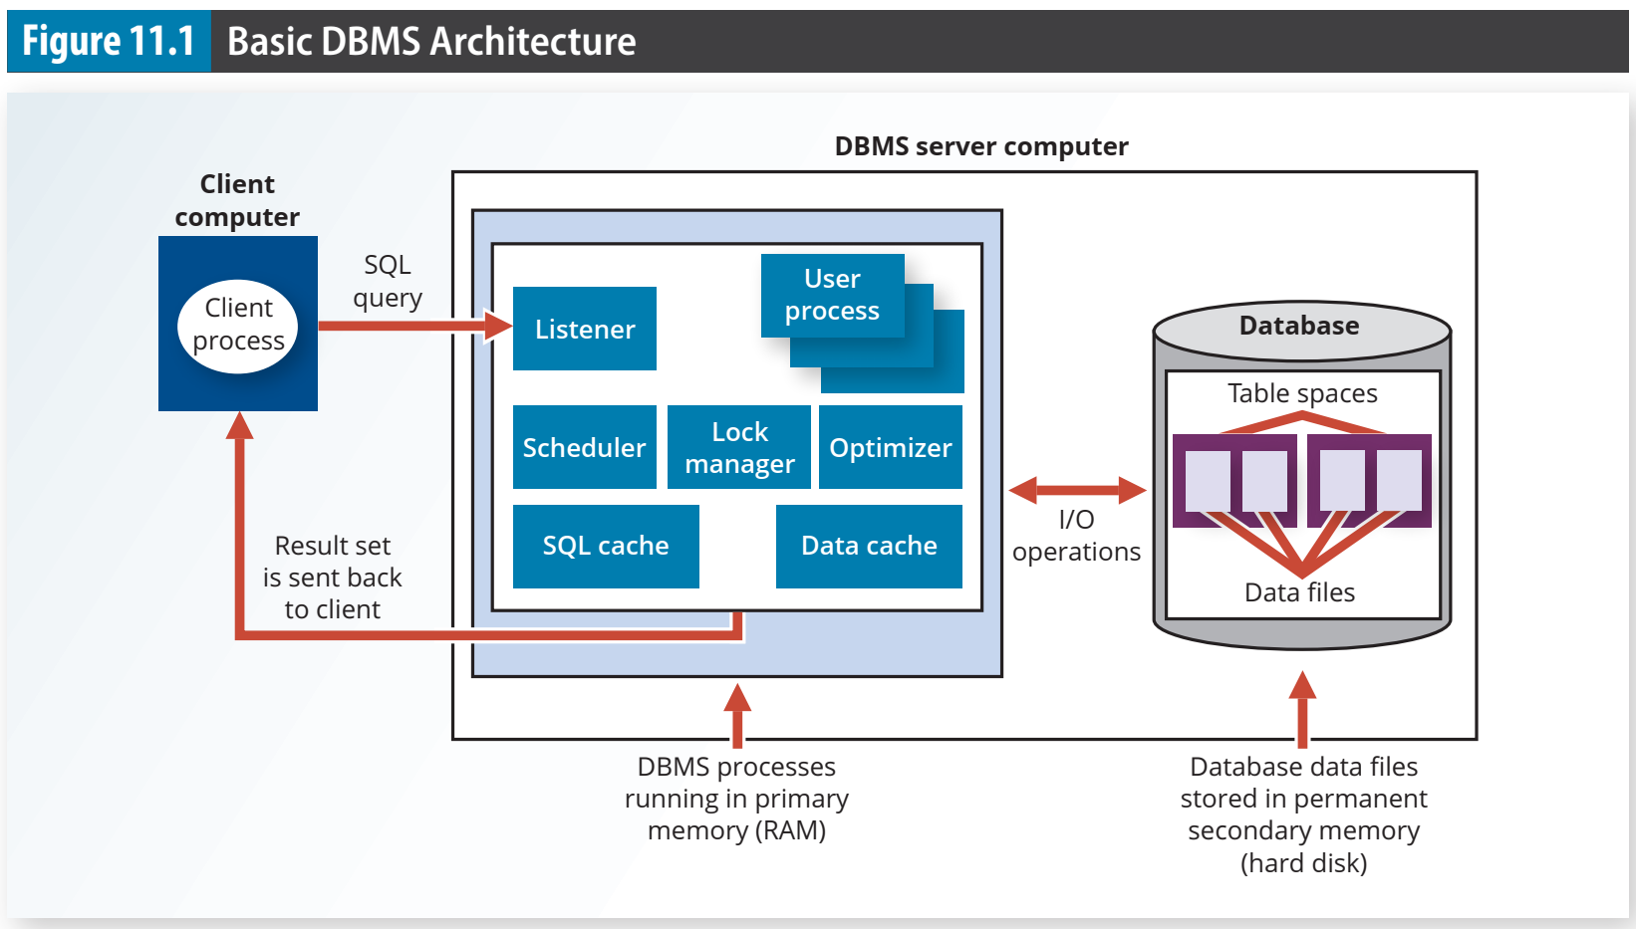

Slide 12
11-1c Database Query Optimization Modes
Most of the algorithms proposed for query optimization are based on two principles: • The selection of the optimum execution order to achieve the fastest execution time • The selection of sites to be accessed to minimize communication costs
automatic query optimization A method by which a DBMS finds the most efficient access path for the execution of a query.
manual query optimization An operation mode that requires the end user or programmer to define the access path for the execution of a query.

Slide 13
11-1c Database Query Optimization Modes
Query optimization algorithms can also be classified according to when the optimization is done.
Static query optimization takes place at compilation time. In other words, the best optimization strategy is selected when the query is compiled by the DBMS.
Dynamic query optimization takes place at execution time. Database access strategy is defined when the program is executed. Therefore, access strategy is dynamically determined by the DBMS at run time, using the most up-to-date information about the database.

Slide 14
11-1c Database Query Optimization Modes
Query optimization techniques can be classified according to the type of information that is used to optimize the query
A statistically based query optimization algorithm uses statistical information about the database. The statistics provide information about database characteristics such as size, number of records, average access time, number of requests serviced, and number of users with access rights. These statistics are then used by the DBMS to determine the best access strategy.
A rule-based query optimization algorithm is based on a set of user-defined rules to determine the best query access strategy. The rules are entered by the end user or database administrator, and they are typically general in nature.

Slide 15
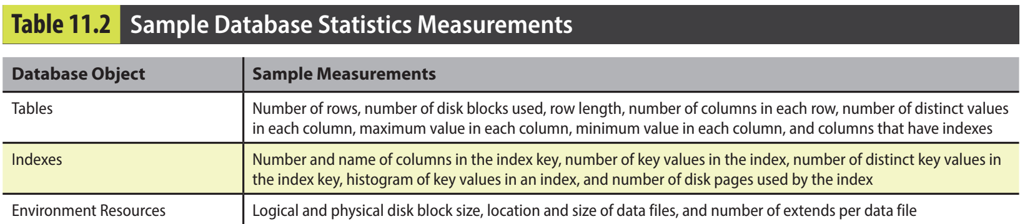
11-1d Database Statistics
database statistics In query optimization, measurements about database objects, such as the number of rows in a table, number of disk blocks used, maximum and average row length, number of columns in each row, and number of distinct values in each column. Such statistics provide a snapshot of database characteristics.

Slide 16
11-2 Query Processing

Slide 17
11-2 Query Processing
What happens at the DBMS server end when the client’s SQL statement is received? In simple terms, the DBMS processes a query in three phases:
1. Parsing. The DBMS parses the SQL query and chooses the most efficient access/execution plan. 2. Execution. The DBMS executes the SQL query using the chosen execution plan. 3. Fetching. The DBMS fetches the data and sends the result set back to the client.

Slide 18
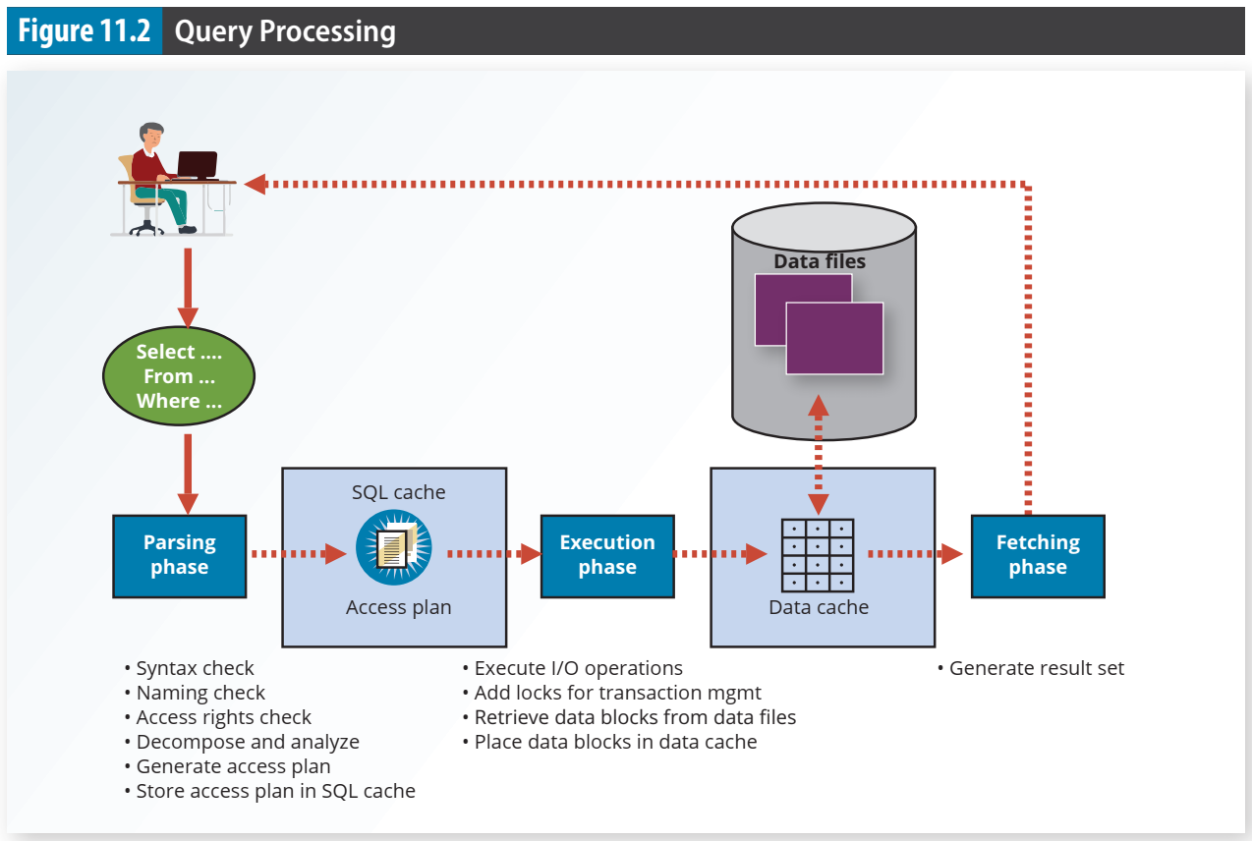

Slide 19
11-2a SQL Parsing Phase
query optimizer A DBMS process that analyzes SQL queries and finds the most efficient way to access the data. The query optimizer generates the access or execution plan for the query.
access plan A set of instructions generated at application compilation time that is created and managed by a DBMS. The access plan predetermines how an application’s query will access the database at run time

Slide 20
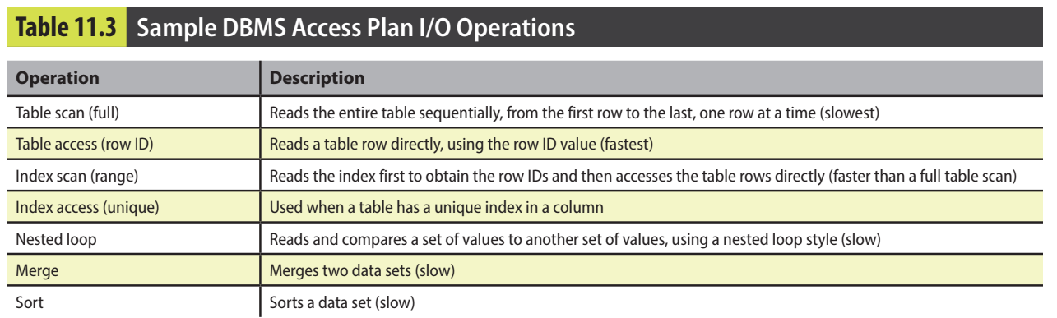

Slide 21
11-2 Query Processing
11-2b SQL Execution Phase
11-2c SQL Fetching Phase
11-2d Query Processing Bottlenecks
query processing bottleneck In query optimization, a delay introduced in the processing of an I/O operation that causes the overall system to slow down

Slide 22
11-3 Indexes and Query Optimization

Slide 23
11-3 Indexes and Query Optimization
Conceptually, a data index is similar to a book index. When you use a book index, you look up a word, which is similar to the index key. The word is accompanied by one or more page numbers where the word is used; these numbers are similar to pointers.

Slide 24
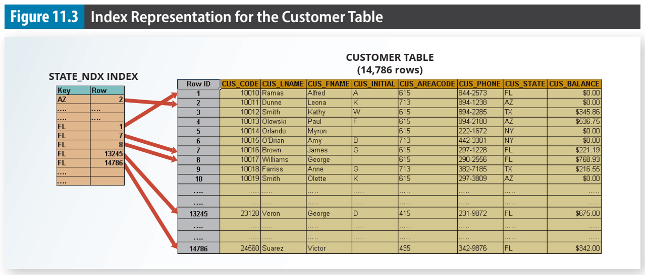

Slide 25
11-3 Indexes and Query Optimization
data sparsity A column distribution of values or the number of different values a column can have.
hash index An index based on an ordered list of hash values
B-tree index An ordered data structure organized as an upside-down tree.
bitmap index An index that uses a bit array (0s and 1s) to represent the existence of a value or condition.

Slide 26
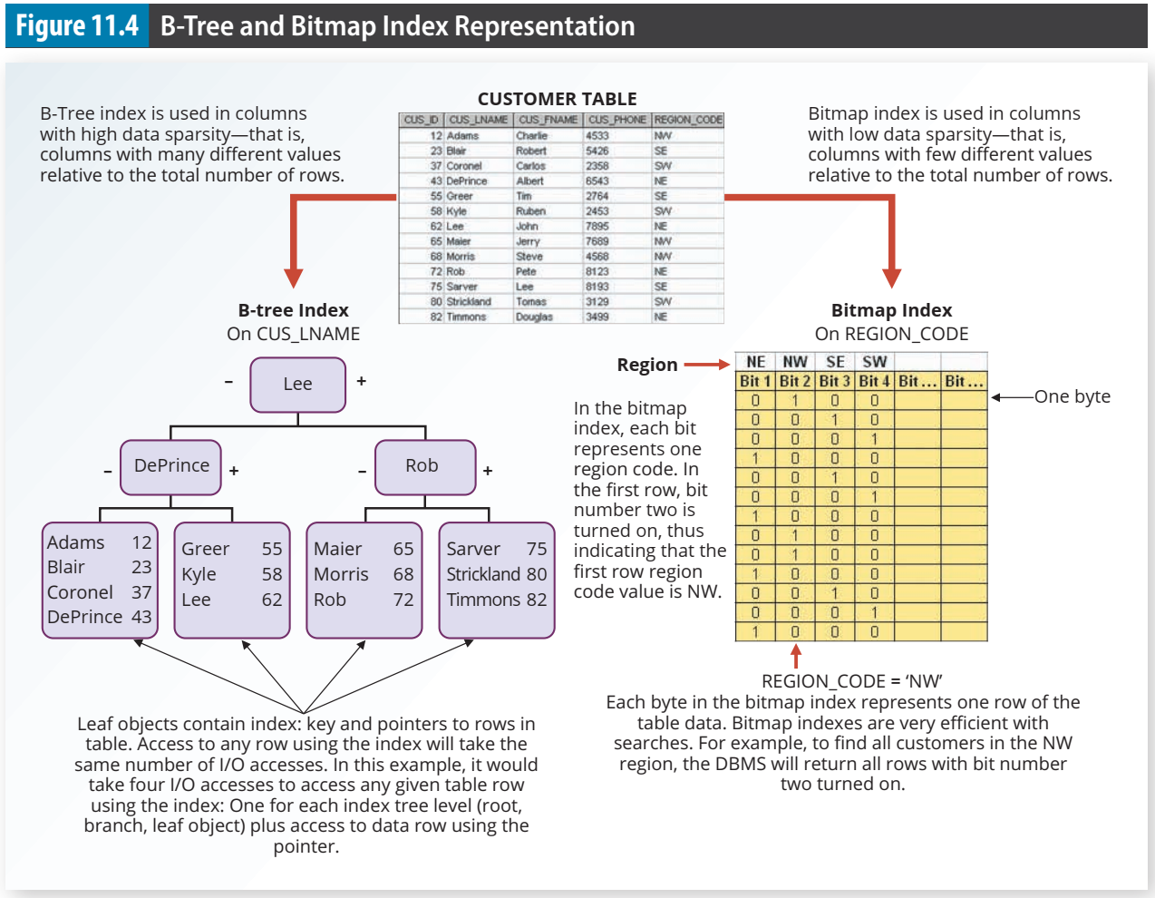

Slide 27
11-4 Optimizer Choices

Slide 28
11-4 Optimizer Choices
Query optimization is the central activity during the parsing phase in query processing. In this phase, the DBMS must choose what indexes to use, how to perform join operations, which table to use first, and so on. Each DBMS has its own algorithms for determining the most efficient way to access the data. The query optimizer can operate in one of two modes:
rule-based optimizer A query optimization mode based on the rule-based query optimization algorithm.
cost-based optimizer A query optimization mode that uses an algorithm based on statistics about the objects being accessed, including number of rows, indexes available, index sparsity, and so on

Slide 29
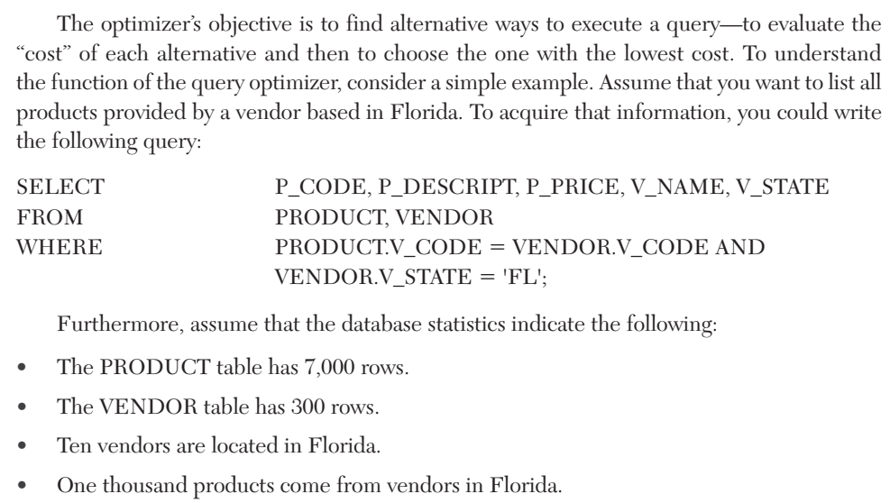

Slide 30
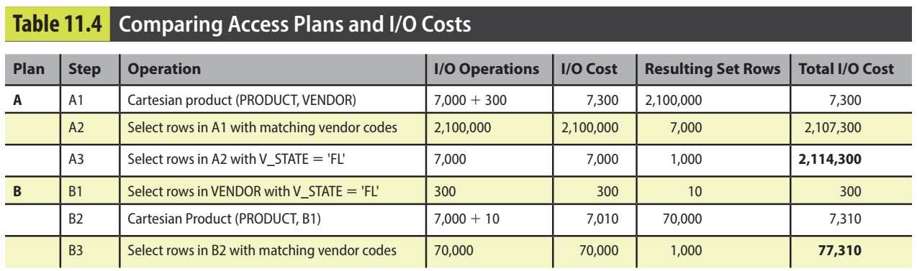

Slide 31
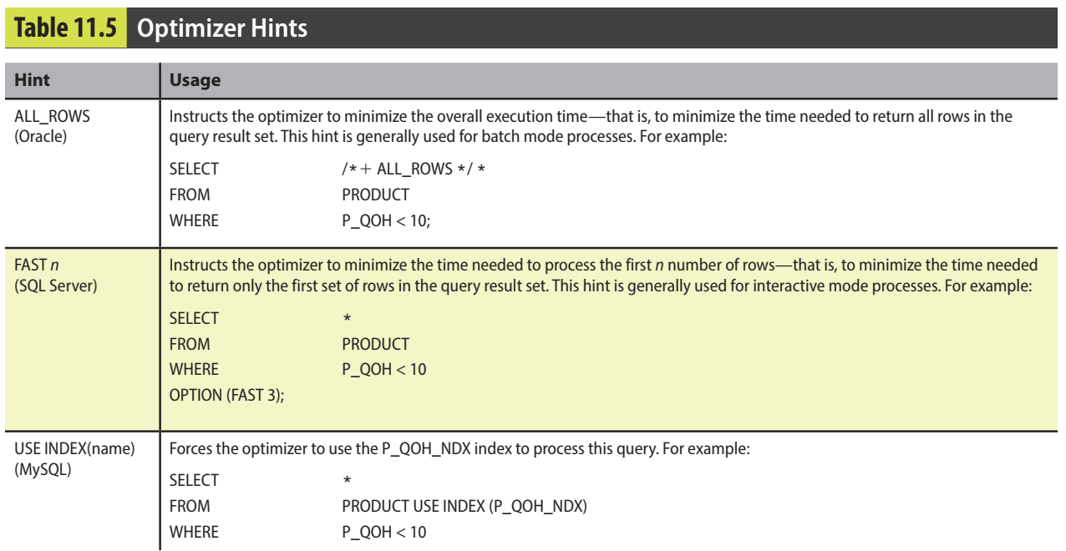
11-4a Using Hints to Affect Optimizer Choices
optimizer hints Special instructions for the query optimizer that are embedded inside the SQL command text.

Slide 32
11-5 SQL Performance Tuning

Slide 33
11-5a Index Selectivity
Indexes are very useful when you want to select a small subset of rows from a large table based on a given condition. If an index exists for the column used in the selection, the DBMS may choose to use it.
index selectivity A measure of how likely an index is to be used in query processing
function-based index A type of index based on a specific SQL function or expression.
You could create an index on EMP_SALARY + EMP_COMMISSION.

Slide 34
11-5b Conditional Expressions
Use simple columns or literals as operands in a conditional expression—avoid the use of conditional expressions with functions whenever possible
Numeric field comparisons are faster than character, date, and NULL comparisons.
Equality comparisons are generally faster than inequality comparisons.
Whenever possible, transform conditional expressions to use literals.
When using multiple conditional expressions, write the equality conditions first.
If you use multiple AND conditions, write the condition most likely to be false first.
When using multiple OR conditions, put the condition most likely to be true first.

Slide 35
11-6 Query Formulation

Slide 36
11-6 Query Formulation
This section focuses on SELECT queries because they are the queries you will find in most applications. To formulate a query, you would normally follow these step:
Identify what columns and computations are required
Identify the source tables
Determine how to join the tables
Determine what selection criteria are needed
Single value to multiple values
Nested comparisons.
Grouped data selection
Determine the order in which to display the output

Slide 37
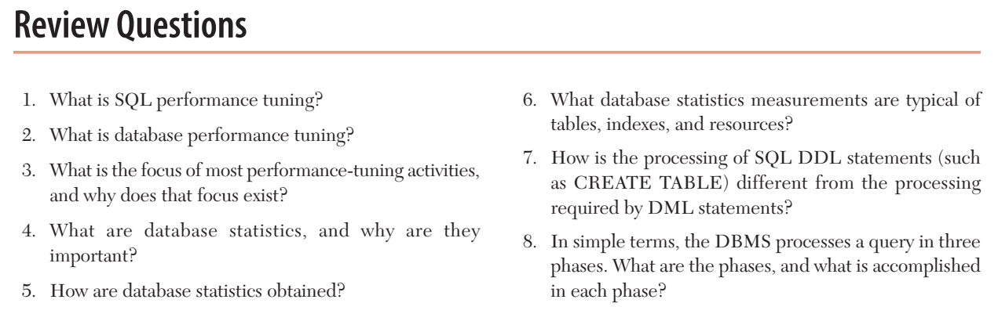

Slide 38
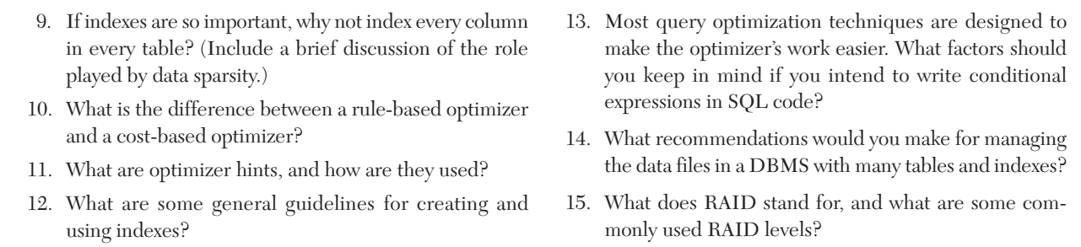

Slide 39
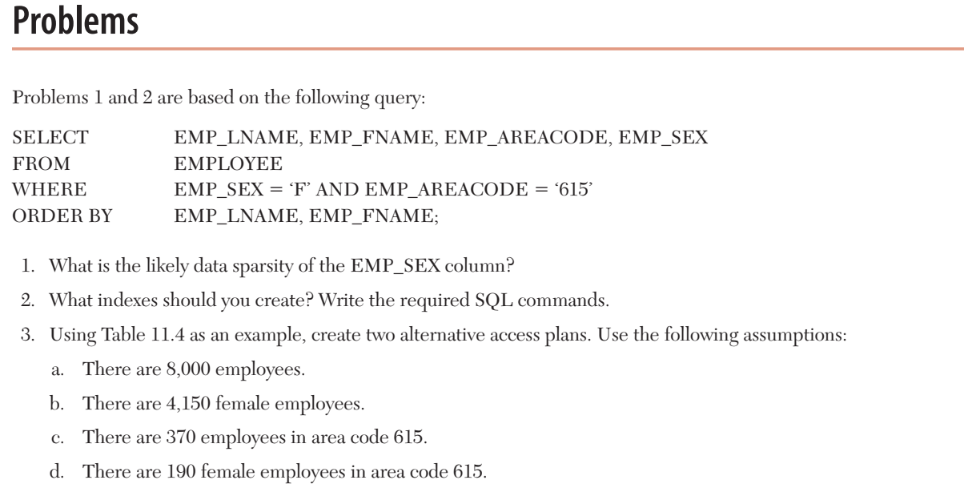

Slide 40
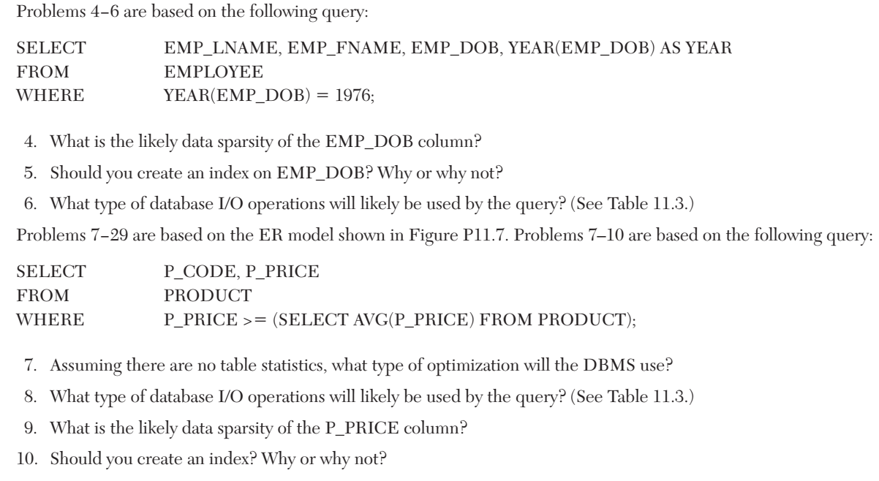

Slide 41
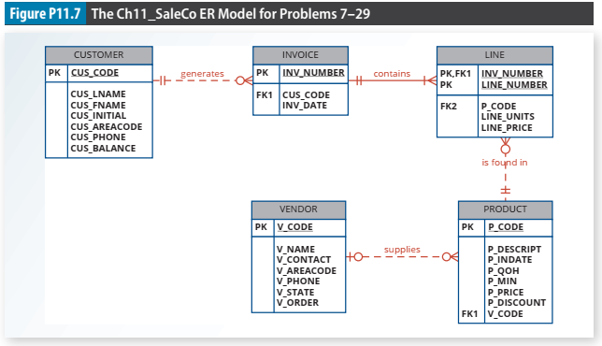

Slide 42
